Slide 1

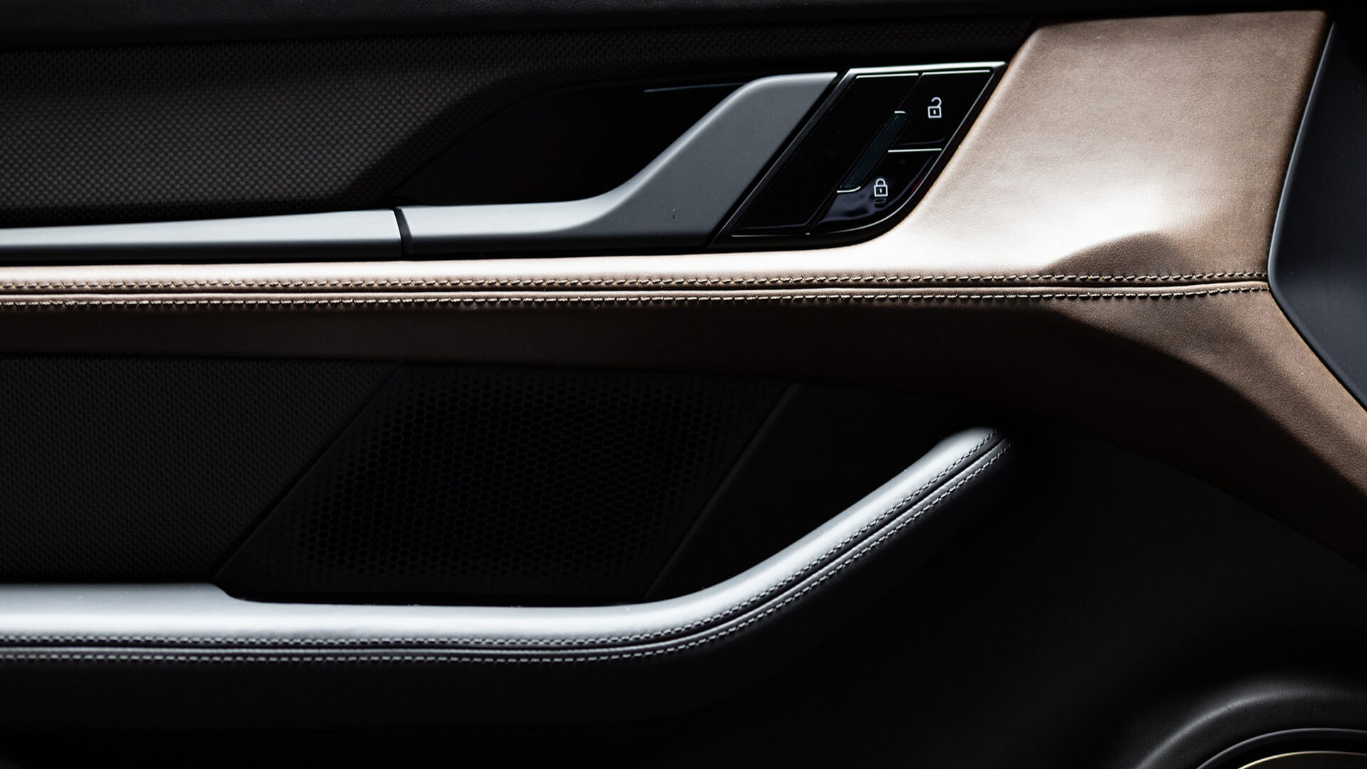
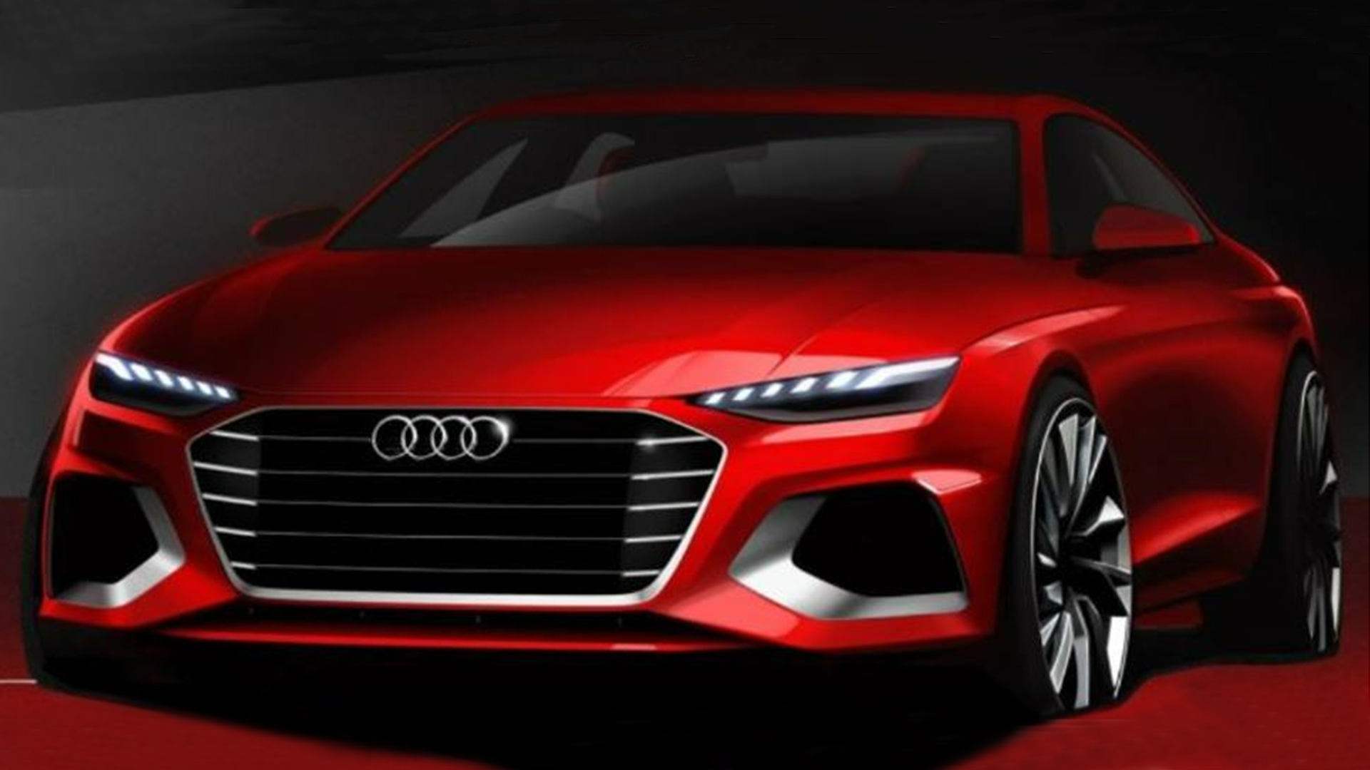
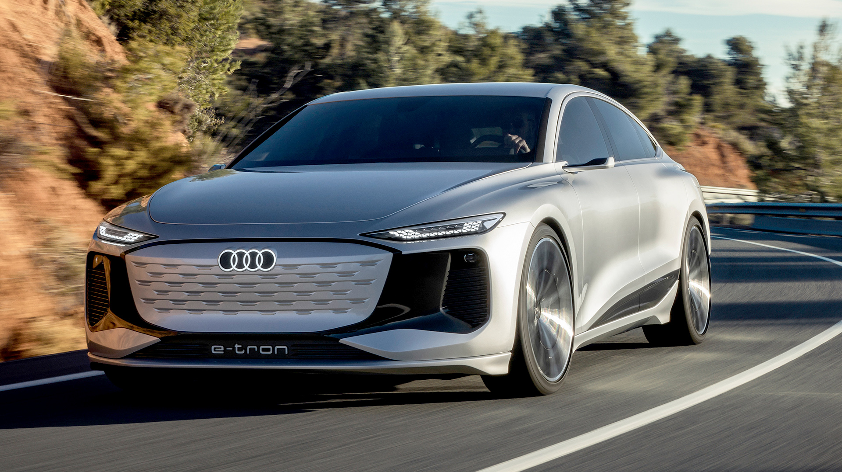
Test product #2
Segment: Rear lamps
Category: Product
Description
Amidst a bustling city, skyscrapers touch the sky, while diverse people rush past, chasing dreams. Street vendors offer mouthwatering delicacies, and art adorns hidden corners. A gentle breeze carries laughter and whispers of undiscovered secrets, ref
Main advantages
Cost reduction
test 1 testing reduction to see if text overflows
Cost reduction
test 1 testing reduction to see if text overflows
Cost reduction
test 1 testing reduction to see if text overflows
Cost reduction
test 1 testing reduction to see if text overflows
Cost reduction
test 1 testing reduction to see if text overflows
• test1
• test2
• test3
Key facts
Applications / Compliance
test1
Intellectual property
test 123
Idea / feasibility study
(TRL 1-3)
Advanced development
(TRL 4-6)
Serial development
(TRL 7-9)
In production
(SOP)
Source: Audi
Source: Audi
1
2
3
4
Contact: Guido Mallee Function:
Division: Health & Medical Company: Motherson Innovations
guido@generous.studio Last modified: 25-07-2023

